Slide 1

Be MY guest
Info 6150 final project
SRIKANTH CHILAKA
RATNESH CHIMNANI
ABHILASH GADE
AKASH BHARADWAJ

Slide 2



GROUNDS
MARKETPLACE FOR STUDENTS TO LEASE OUT ROOMS AT AFFORDABLE PRICES
INTERNATIONAL STUDENTS FIND DIFFICULTY AS NO PLATFORM EXISTS FOR TEMPORARY ACCOMODATION BEFORE AND DURING BREAKS

Slide 3
DESCRIPTION
WEBSITE FOR LEASING OUT ROOMS TO STUDENTS. ALLOWS FOR EMAIL CONTACT OF OWNERS, PAYMENT THROUGH CARD, YOUTUBE TRAILER OF ROOM BEING LEASED OUT, AND LIVE GEOLOCATION IN GOOGLE MAPS BASED ON ADDRESS POSTED.

Slide 4
TECH STACK
SCSS
MongoDB
Mongoose
MongoDB Compass
React JS
Redux
NodeJS
Express JS
ChakraUI
ReachUI
React-forum-hooks
REST API
MUI

Slide 5

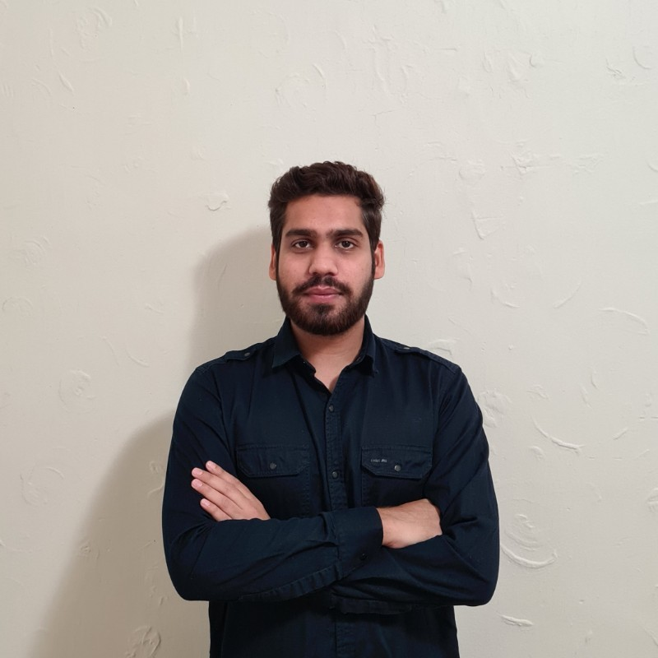
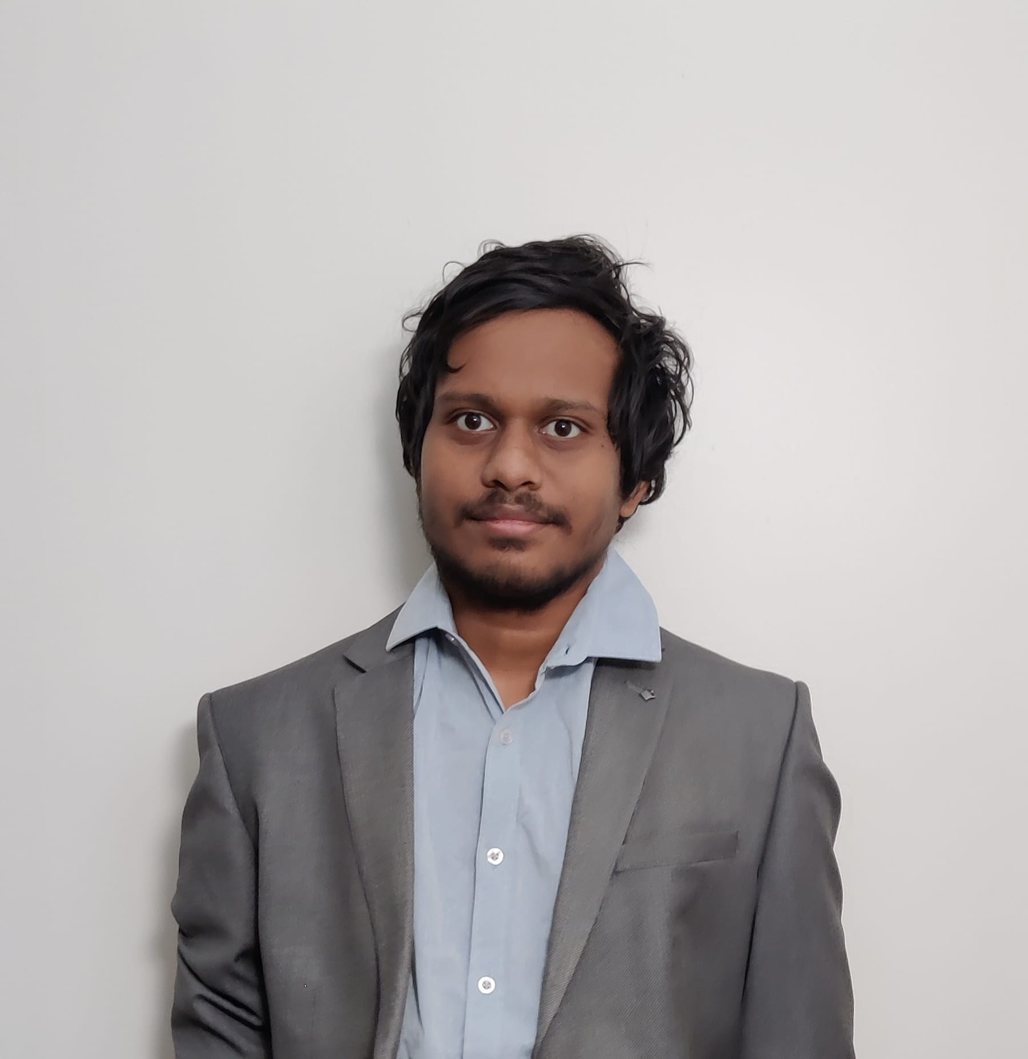
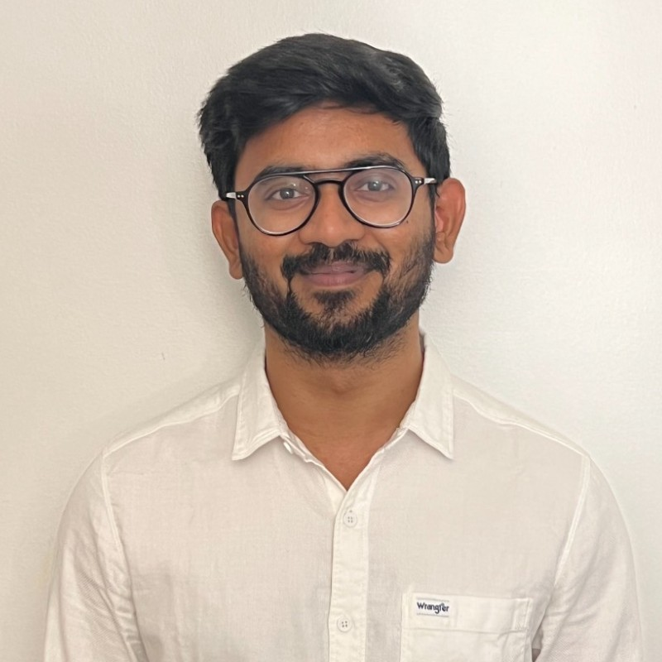
Team-Roles
Akash Bharadwaj
Rathnesh
UI/UX Design- MUI
UI/UX- SCSS
Implemented Backend(RestAPI) Schema using Express JS and maintained global states using Redux store
Implemented a Contact Lessor page using Email JS
Created and designed the landing Page and also used Google maps API, GeoCode and Places auto complete API
Form validations using React form Validation Hooks
Abhilash Gade
Srikanth Chilaka
UI/UX Design-Chakra UI
UI/UX - SCSS
Implemented user Authentication(Signup/Signin) using Auth0.
Implemented Payments using Stripe API.
Made Lessor/Lessee pages and implemented logic behind them using CRUD operations
Persisted Auth by storing a token in DB
Created Post rooms feature.

Slide 6
Api used
Auth0
StripeApi
GeoCode Api
Places Auto Complete
Google Maps API
Email Js API
REST API

Slide 7
REFERENCES
https://stripe.com
https://auth0.com

Slide 8

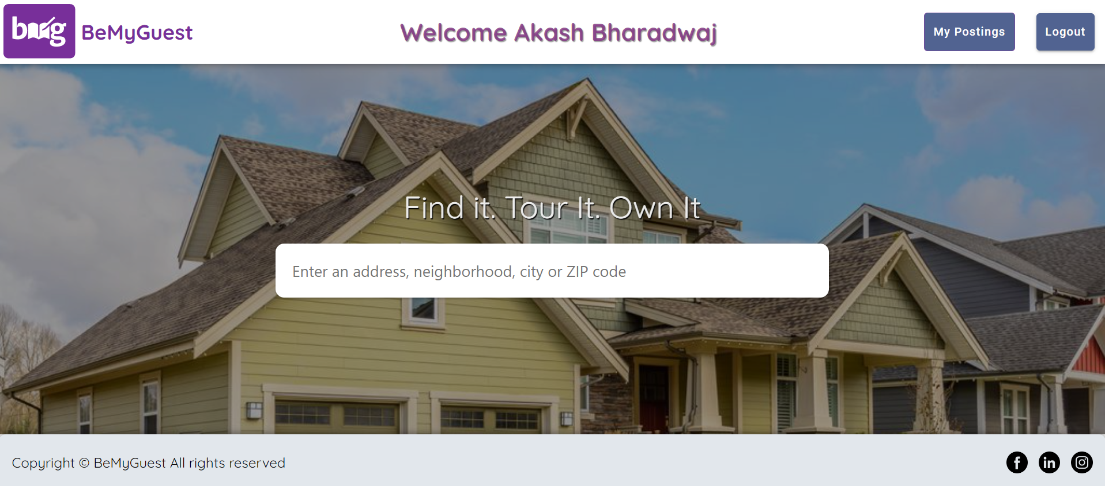
Landing Page

Slide 9
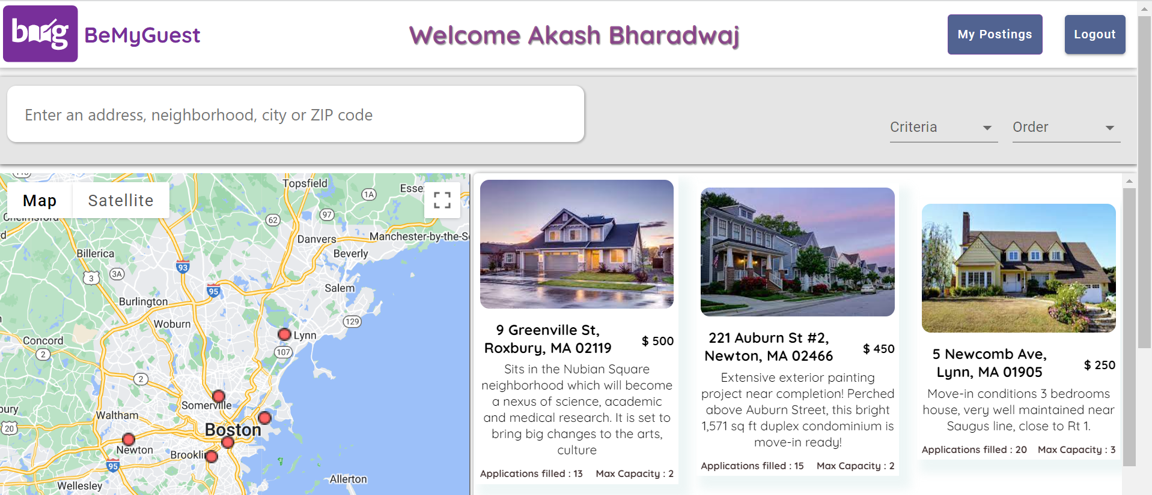
Maps and location based search

Slide 10
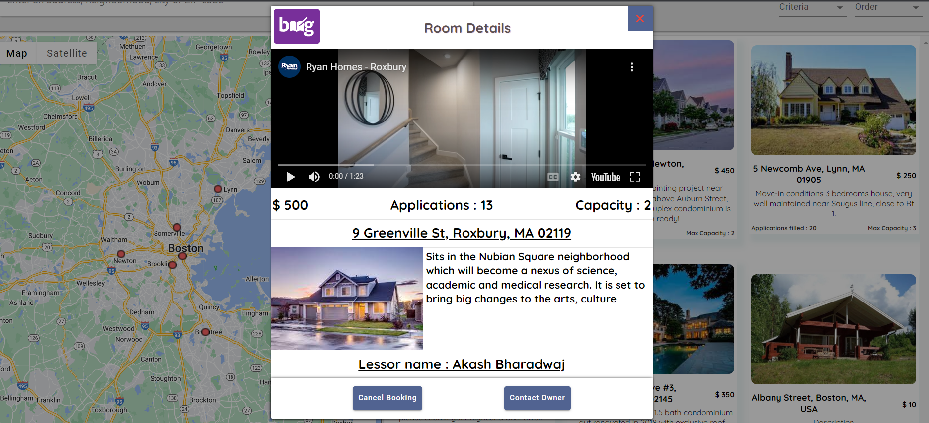
Booking option post login

Slide 11
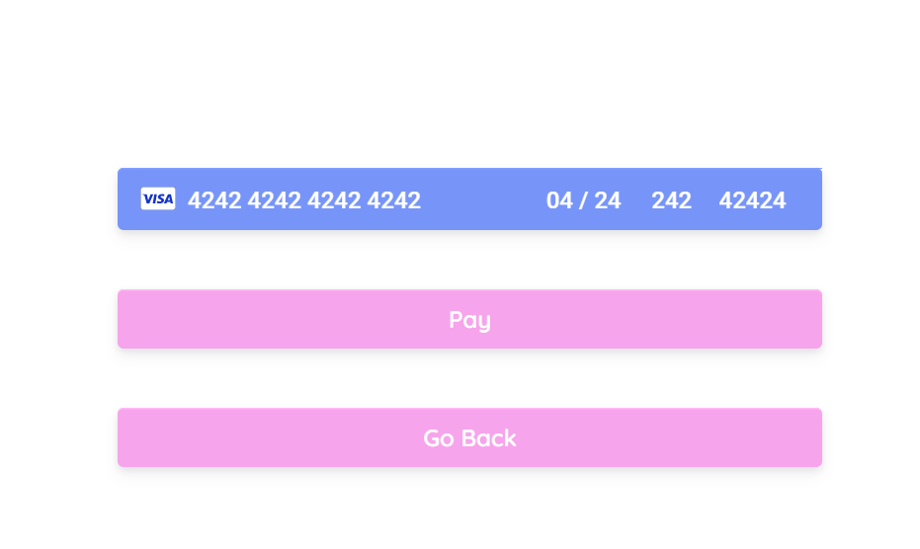
Payments API

Slide 12
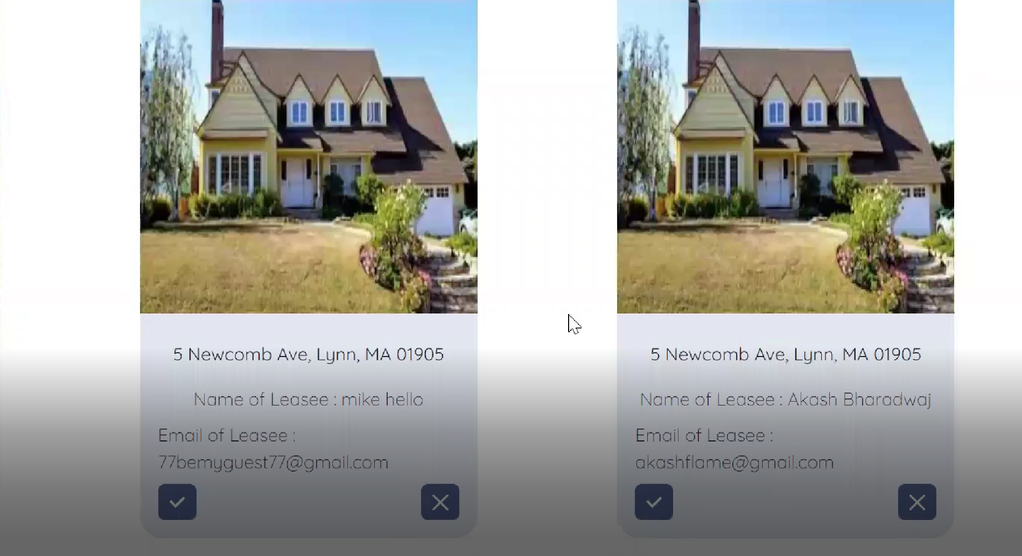
Approve and Reject option for the lessor

Slide 13

Thank You!

